Slide 1



Universal healthcare database
Group - 6
Jeevan Kumar - 6
Sai Bhaskar - 33
Steven Quintana - 54

Slide 2
INTRODUCTION
The Universal Healthcare Database System, built on MongoDB, centralizes patient records from multiple providers into a flexible, document-based NoSQL database. This system improves access to comprehensive health information, streamlines data transfer when patients switch providers, and provides research labs with centralized, reliable access to large health datasets, enhancing the accuracy of health research and enabling better patient care and analysis.

Slide 3
PROBLEM STATEMENT
In healthcare, the decentralization of patient data across multiple systems hinders comprehensive care and early diagnosis. Organizations like CommonWell are addressing this by using ETLs to centralize data, making it more accessible. A universal interface linked to a document-based NoSQL database could enhance flexibility and maintainability, accommodating the dynamic nature of patient records. This centralization also facilitates research by providing easier access to large datasets.

Slide 4


Tools used:
Frontend:
Utilized HTML/CSS/Javascript in all in one HTML file
Communicates to the Python server via Fetch HTTP requests
Backend:
Backend was created entirely in the Python language
Utilized Flask for HTTP request routing and returning data to the frontend app
Utilized PyMongo to integrate queries to MongoDB from the server app
Database:
Utilized a Document NoSQL database with MongoDB
Created database locally with MongoDB Compass
Chose a document DB for its flexibility and ease of understanding for programmers

Slide 5
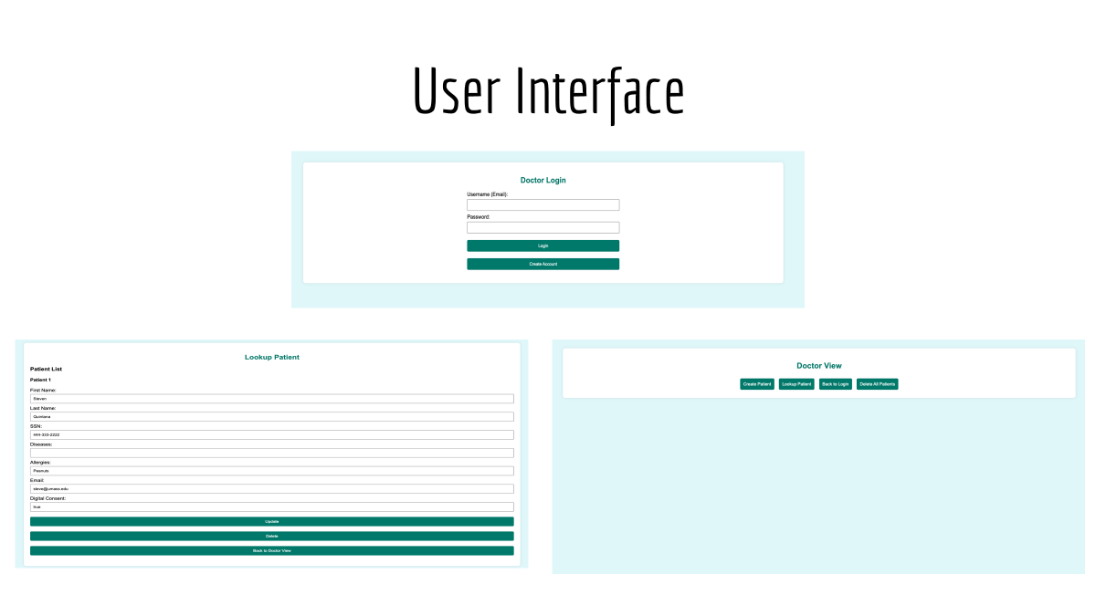

Slide 6
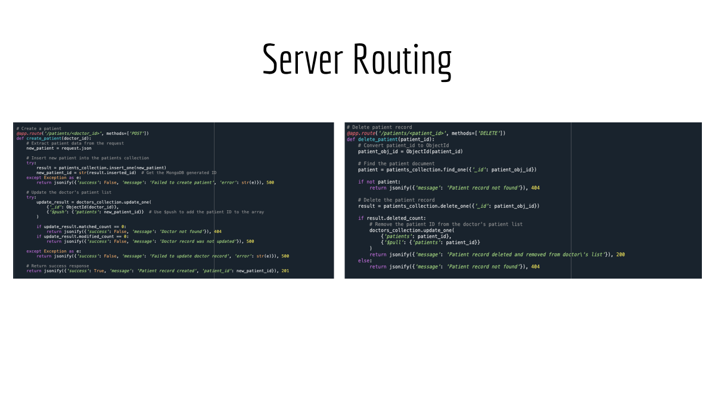

Slide 7
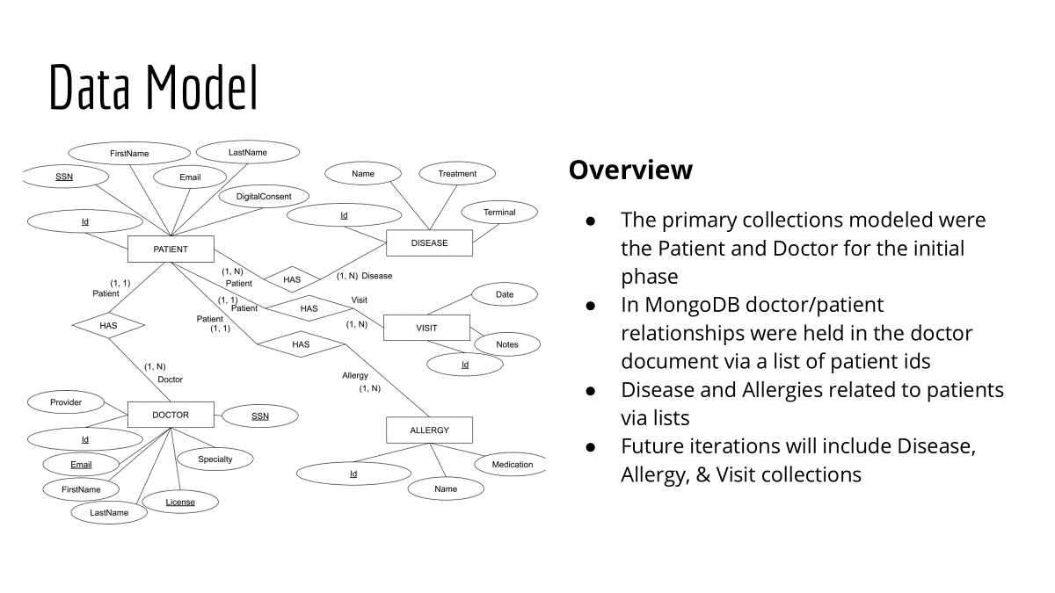
























DATA MODEL

Slide 8

FUTURE ENHANCEMENTS
Add further collections so doctors can pull lists of allergies, diseases, and providers a part from the patient records
Add Front End validations
Add further ETL scripts to transform data from multiple provider sources
Create a secure API for researchers to use

Slide 9
THANK YOU
QUESTIONS?

